Slide 1

Requirements Quality
Quality Measures
Verification
Validation
Notes:
‹#›

Slide 2

Requirements Standards
IEEE 830-1998
A “Best Practices” document for Requirements
Historically well-known for its language – “shall”
Related to Software Lifecycle Process std IEEE 12207
http://ieeexplore.ieee.org/stamp/stamp.jsp?arnumber=720574
SRS Benefits:
Basis for agreement between customers and suppliers
Reduce development effort
Complete an SRS before design and find problems earlier
Basis for estimating costs and schedules
Baseline for V&V
Facilitate transfer
To users, new developers, or new technology
Basis for enhancement

Slide 3

Requirements Standards
IEEE 830 Best Practices
Do not embed design in the requirements spec
However, design “constraints” may be expressed
Do not embed project requirements in the spec
Joint ownership/preparation between customer & supplier
Supports evolution
Only “anti-waterfall” statement – embrace change
Prototyping
Use as an elicitation technique
A “good” SRS is:
Correct, Unambiguous, Complete
Consistent, Prioritized, Verifiable,
Modifiable, Traceable

Slide 4

Requirements Quality Measures
How can you tell if your requirements are “good”?
IEEE-830: IEEE Recommended Practice for Software Requirements Specifications suggests 8 quality measures for requirements
Correct
Unambiguous
Complete
Consistent
Ranked for importance and stability
Verifiable
Modifiable
Traceable

Slide 5
Requirements Quality Measures
Correctness:
IEEE-830: An SRS is correct if, and only if, every requirement stated therein is one that the software shall meet
“There is no tool or procedure that ensures correctness”
Extra Stated Requirement: gratuitous “nice-to-haves”
A soundness property
Forces:
Poor elicitation
Unfocused team
Lack of joint ownership
Solutions:
Peer and Customer Reviews
Traceability
Reviews for consistency with other project documentation
Especially the Vision document
Extra Features
Incorrect!
User
Needs

Slide 6
Requirements Quality Measures
Completeness:
IEEE-830: A set of requirements is complete “if and only if it describes all significant requirements of concern to the user, including requirements associated with functionality, performance, design constraints, attributes, or external interfaces”
User Needs
Incompleteness
Stated
Reqs
IEEE-830 calls out the use of “TBD” as one that violates
Completeness; but then goes on to say that TBDs may be
necessary, so put in information that helps resolve them

Slide 7

Requirements Quality Measures
Completeness - A hard quality metric to measure
Nonfunctional reqs may be overlooked or specified incompletely
Examples: % uptime, max downtime, response times, etc.
How often does the customer not understand the cost-benefit?
Functional reqs: how do you know when you’ve got them all?
You are building something new
User assumes from domain knowledge, but you don’t know!
IEEE-830 says don’t use “TBD” without a procedure to remove it
Forces:
Assumed user/customer knowledge
Inability to concretely define scope
Scope may grow into unbounded “wishlist”
Lack of a cohesive vision puts anything into play
Solutions:
Joint reviews with users/customers
Developer “teaches” material back to users/customers
Prototyping

Slide 8

Requirements Quality Measures
Unambiguous:
IEEE-830: A requirement is unambiguous “if and only if it can be subject to only one interpretation”
Often the biggest problem with requirements
You might get all stakeholders to agree on a complete and consistent set of requirements – but then the delivered system still doesn’t match customer expectations!
Forces:
Imprecision of natural language
Communication gap between customers and developers
Requirements document as “proxy” for user needs
Solutions:
Multi-level reviews
Define test cases a priori
Prototypes
Make it measurable!

Slide 9
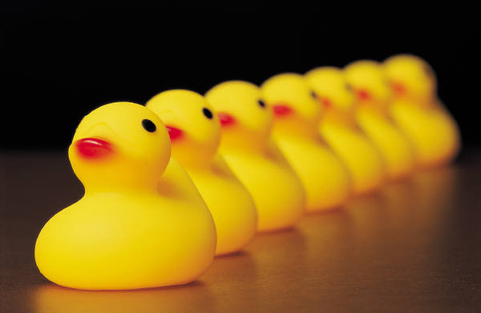
Requirements Quality Measures
Consistency:
IEEE-830: A requirement set is consistent “if and only if no subset of individual requirements described within it are in conflict with one another”
Tough to tell inconsistent from ambiguous requirements
Example (Leffingwell & Widrig):
“All employees who are 65 or older at the end of the calendar year shall receive a bonus of no more than $1000”
“All employees with 10 years or more service at the end of the calendar year shall receive a bonus of $500”
Does the 65 year-old employee who is a 15-year veteran receive both?
Forces
Doing requirements in “isolation”
Creating blind “mandates”
Solutions
Extensive manual review (prototypes aren’t as helpful!)

Slide 10

Requirements Quality Measures
Requirements Ranked by Importance and Stability
Importance 🡪 Prioritizing, an exercise in scope
Assign descriptors to the requirements
Cost, Risk, Difficulty, LOI, LOE, ROI
Note these are only indirectly related to developer concerns
Stability
Identifying the requirements that will most likely change
A form of risk as identified by the Requirements descriptor
Forces:
Lack of clear direction;
Infighting between marketing and dev
Solutions:
Clarity of vision
Strong ownership/leadership
Balanced input

Slide 11

Requirements Quality Measures
Verifiability:
IEEE-830: A requirement is verifiable “if and only if there exists a finite, cost-effective process with which a person or machine can determine that the developed software system does indeed meet the requirement”
Not a property of the requirement, but of the process!
Implies that if verification techniques improve, the verifiability of a given requirement might increase
Forces:
Requirements not worded in a way amenable to testing
Poor, ill-defined processes
Lack of traceability
Solutions
Testing-aware wording
Process-focus with pervasive QM

Slide 12
Requirements Quality Measures
Modifiable:
IEEE-830: A requirement set if modifiable “if and only if its structure and style are such that any changes to the requirements can be made easily, completely, and consistently, while retaining the existing structure and style of the set”
A misnomer: Requirements will be modified. How you deal with the change is what is really important.
Forces:
Many forces for changing requirements
Lack of infrastructure (tools and methods) to support change
Solutions:
Requirements change management processes
Tools
Cultural – “embrace change”

Slide 13

Requirements Quality Measures
Traceable:
IEEE-830: A requirement is traceable “if and only if the origin of each of its component requirements is clear, and there is a mechanism that makes it feasible to refer to that requirement in future development efforts”.
Typically required in high QA environments
Medical, weapons, anything where human life is at risk
A controversial point for Agile methods
Forces:
Need ability to go forward and backward through artifacts
Systems where accountability is a virtue
Solutions:
Identifiers on all requirements (all artifacts)
Repository management

Slide 14
Requirements Quality Measures
Other Quality Measures (non IEEE-830):
Understandable: Whose vocabulary is used? Who is the target audience?
Cohesive: Do they make sense together as a unit? Do they support business objectives as a whole?
Feasible: Can we really do this stuff?
Corollary: Estimatable
Concise: Are gratuitous elements removed? Is the requirements set in some sense minimal? Wording?
Managed: Are the requirements under some form of managed, repeatable process?

Slide 15
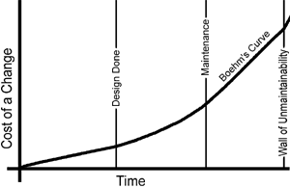
Requirements Validation
“the process of evaluating a system or component during or at the end of the development process to determine whether it satisfies specified requirements” – IEEE 1012-1986
Validation is done with respect to the quality attributes discussed earlier
In other words, it is not just testing (Verification)!
Requirements error costs are high so validation is important
Fixing a requirements error after
delivery may cost up to 100 times
the cost of fixing an implementation error

Slide 16


Requirements Validation
Requirements Review
Review requirements against goals & objectives of system
Check for omissions, ambiguity, incompleteness, and inconsistency
Document risk.
Discuss how system will be tested.
Requirements Prototyping
“Proof-of-concept” useful for eliciting & analyzing reqs
For similar reasons, can assist with validation
Caution: prototypes may take shortcuts on scope in exchange for time/cost savings. They are not a real working system!
Requirements-based Testing
Use case driven testing - can you define?
Acceptance Tests

